Slide 1




버그 헌팅 맨땅에 헤딩
Hackyboiz 정준수
© Hackingcamp. All Rights Reserved

Slide 2

발표자 소개
Hackyboiz 팀 소속
화이트햇 스쿨 1기 수료
컴퓨터공학 전공 (취준생 ㅎㅎ)
FINDWAY 보안 동아리
© Hackingcamp. All Rights Reserved

Slide 3
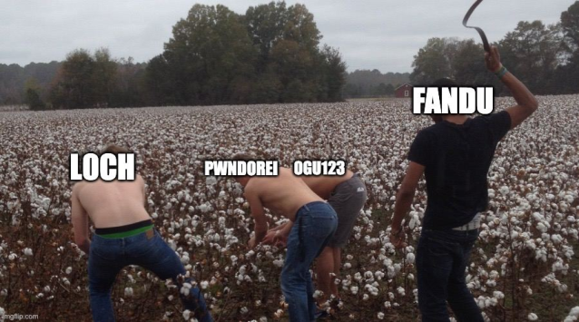
발표 소개
리얼 월드 경험에서 느낀 점
Case Study를 통한 두려움 없애기!
타겟 : 국내 이미지 뷰어 프로그램(32bit)
성과 : RCE 4개
© Hackingcamp. All Rights Reserved

Slide 4
Agenda
Seed File 구조
Vtable Overwrite
Case Study 1
Case Study 2
Case Study 3
소감
© Hackingcamp. All Rights Reserved

Slide 5
1. Seed File 구조
© Hackingcamp. All Rights Reserved

Slide 6
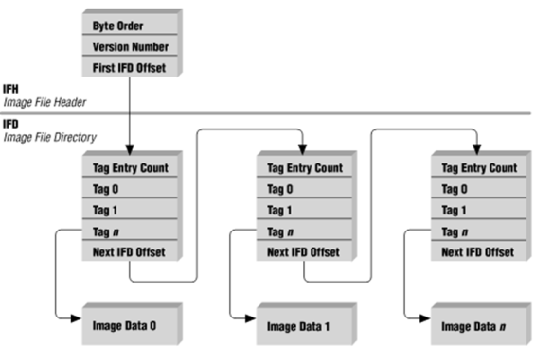
Seed File 구조
TIFF(Tag Image File Format)
하나의 이미지를 위한 여러 개의 태그가 존재
파일에 여러 개의 이미지를 담을 수 있는 다중 문서 파일
© Hackingcamp. All Rights Reserved

Slide 7

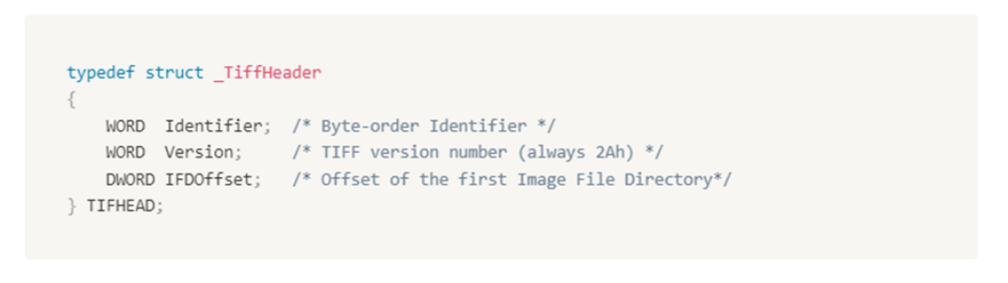


Seed File 구조
IFH(Image File Header)
© Hackingcamp. All Rights Reserved

Slide 8

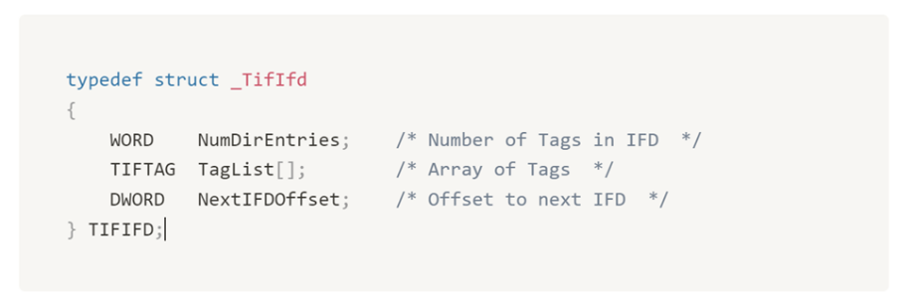
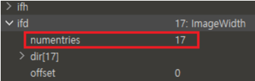
Seed File 구조
IFD(Image File Directory)
© Hackingcamp. All Rights Reserved

Slide 9
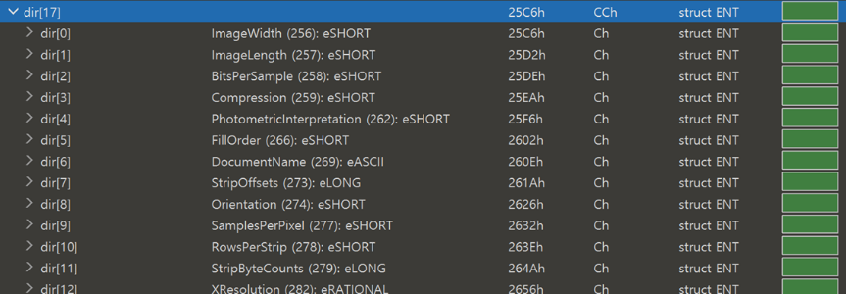
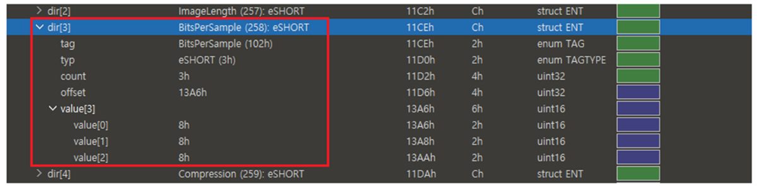
Seed File 구조
IFD : TAG
© Hackingcamp. All Rights Reserved

Slide 10
2. Vtable Overwrite
© Hackingcamp. All Rights Reserved

Slide 11

2. Vtable Overwite
Vtable Overwite
Vtable은 c++ 기능인 Virtual Function(가상 함수)을 위해 사용
Vtable 안에 함수 포인터들이 배열 형태로 저장됨
© Hackingcamp. All Rights Reserved

Slide 12
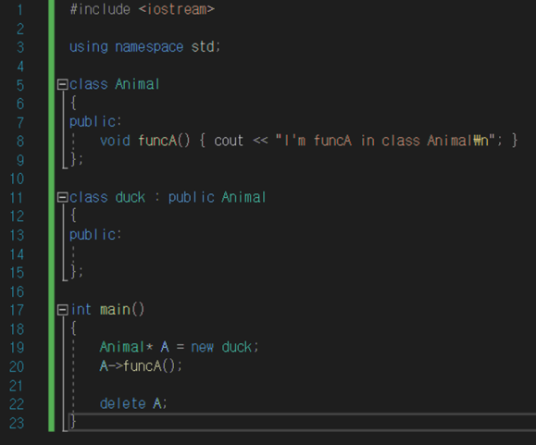
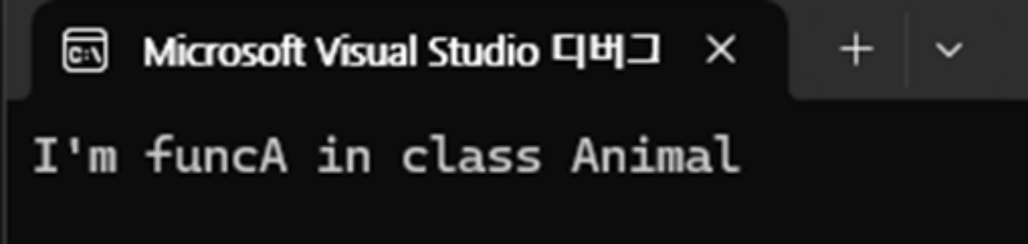
Vtable Overwite
Virtual Function
© Hackingcamp. All Rights Reserved

Slide 13
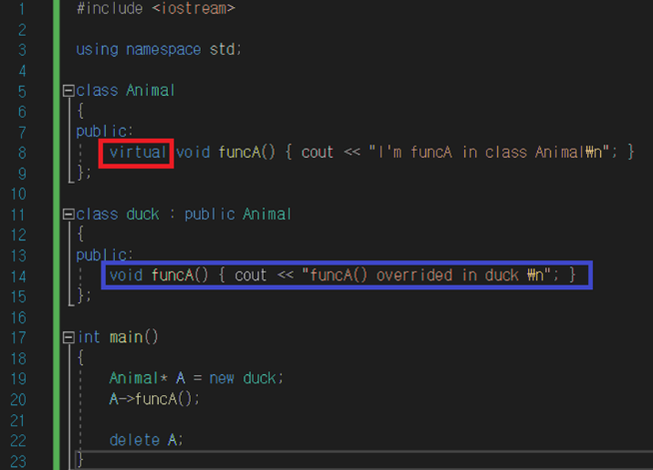
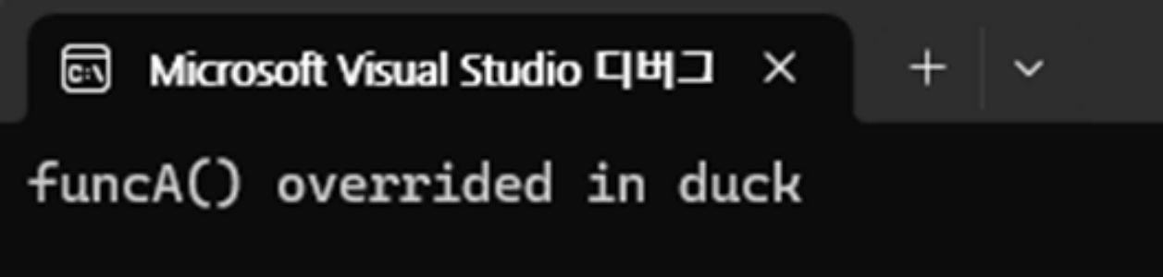
Vtable Overwite
Virtual Function
© Hackingcamp. All Rights Reserved

Slide 14
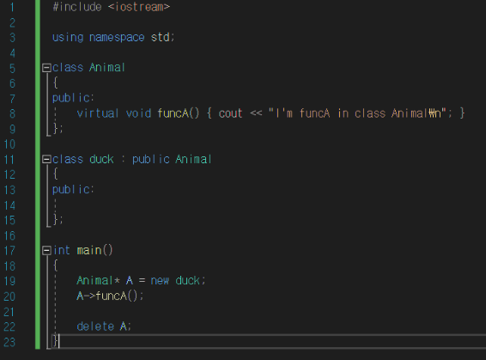



2. Vtable Overwite
Vtable Overwite
Vtable
vtable
&funcA
funcA()
"I'm funcA..
© Hackingcamp. All Rights Reserved

Slide 15

2. Vtable Overwite
Vtable Overwite
Vtable
vtable
&funcA
funcA()
"I'm funcA..
© Hackingcamp. All Rights Reserved

Slide 16
2. Vtable Overwite
Vtable Overwite
vtable
&funcA
funcA()
"I'm funcA..
vtable
&funcA
© Hackingcamp. All Rights Reserved

Slide 17
2. Vtable Overwite
Vtable Overwite
vtable
&funcA
funcA()
"I'm funcA..
vtable
&funcA
© Hackingcamp. All Rights Reserved

Slide 18
2. Vtable Overwite
Vtable Overwite
vtable
&funcA
funcA()
"I'm funcA..
vtable
&funcA
funcA()
“funcA()...
© Hackingcamp. All Rights Reserved

Slide 19





2. Vtable Overwite
Vtable Overwite
vtable
…
&funcA()
funcA()
cout << ...
&vtable
Object
member1
member2
© Hackingcamp. All Rights Reserved

Slide 20
2. Vtable Overwite
Vtable Overwite
vtable
…
&funcA()
funcA()
cout << ...
vptr
&vtable
Object
member1
member2
© Hackingcamp. All Rights Reserved

Slide 21
2. Vtable Overwite
Vtable Overwite
vtable
write 0
&funcA()
funcA()
cout << ...
vptr
&vtable
Object
member1
member2
write X
© Hackingcamp. All Rights Reserved

Slide 22
2. Vtable Overwite
Vtable Overwite
vtable
&funcA()
funcA()
cout << ...
vptr
&vtable
Object
member1
member2
Target!
© Hackingcamp. All Rights Reserved

Slide 23
2. Vtable Overwite
Vtable Overwite
vtable
&funcA()
funcA()
cout << ...
vptr
&vtable
Object
member1
member2
0xABCD
41414141
11111111
11111111
© Hackingcamp. All Rights Reserved

Slide 24
Vtable Overwite
vtable
&funcA()
funcA()
cout << ...
0xABCD
Object
member1
member2
0xABCD
41414141
11111111
11111111
© Hackingcamp. All Rights Reserved

Slide 25
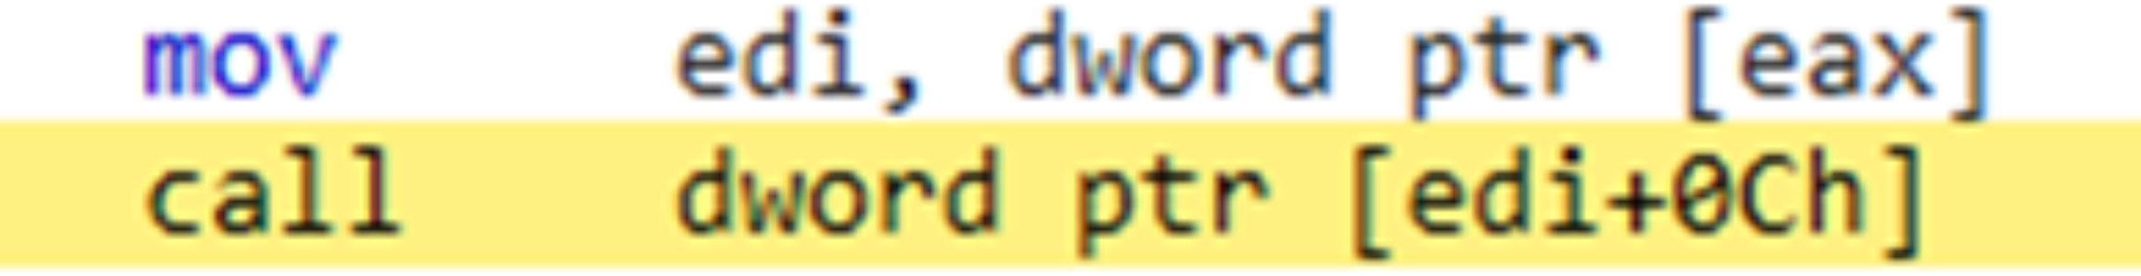
Vtable Overwite
C++ 프로그램
임베디드 장비 펌웨어
Call dword ptr []
© Hackingcamp. All Rights Reserved

Slide 26
3. Case Study 1
© Hackingcamp. All Rights Reserved

Slide 27
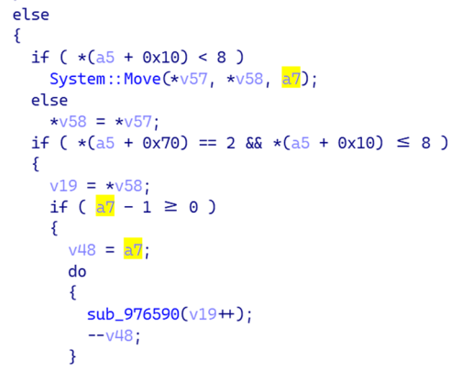
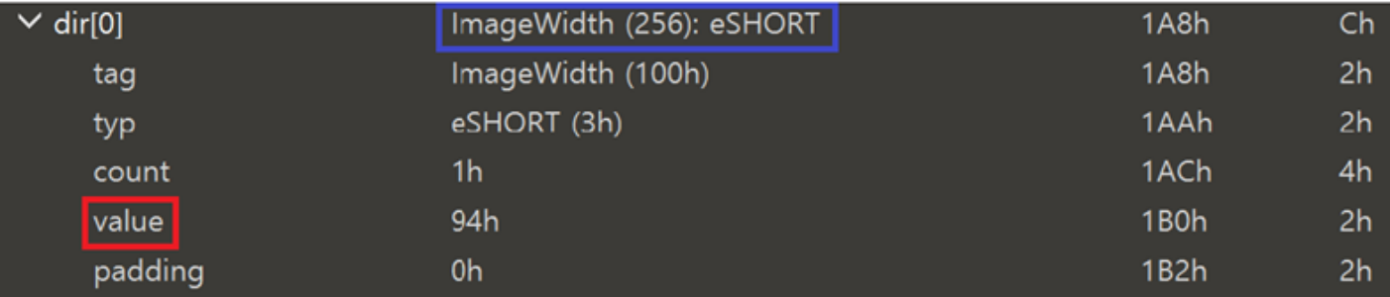
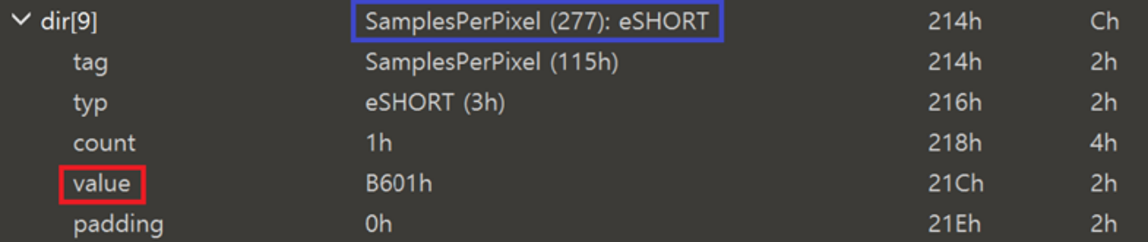
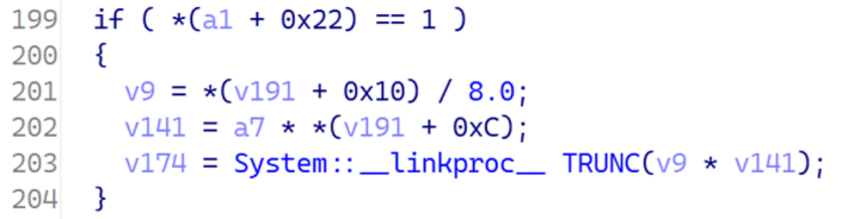
Case Study 1
0xd2712
0x94 * 0xB601
© Hackingcamp. All Rights Reserved

Slide 28
3. Case Study 1
Case Study 1
0x9110
0x44
0x1111
0x44 * 0x1111
© Hackingcamp. All Rights Reserved

Slide 29
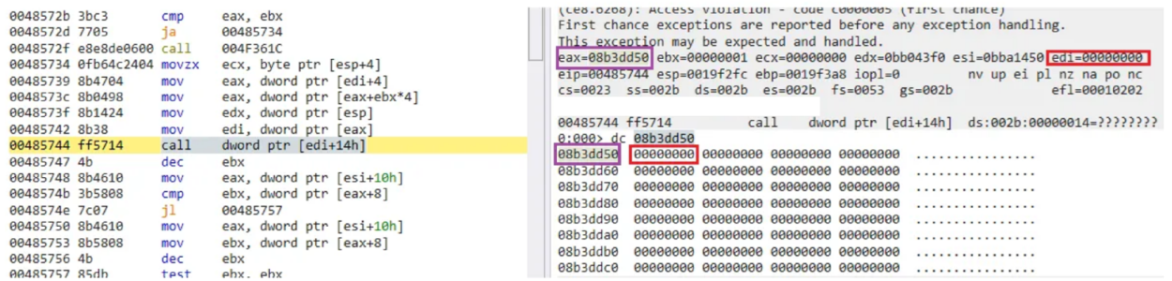
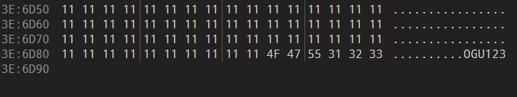
3. Case Study 1
Case Study 1
vtable 덮었다!
2. NULL? 파일 사이즈 확인하자!(0x2F0 -> 0x3E6D90)
© Hackingcamp. All Rights Reserved

Slide 30
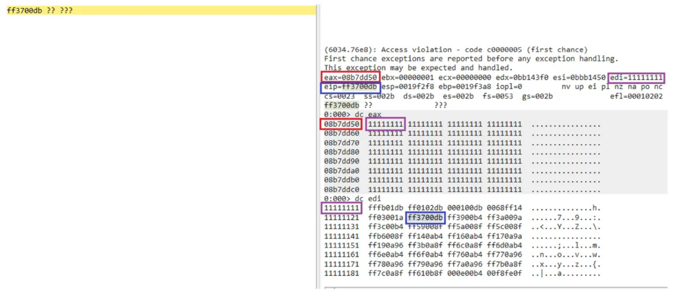
3. Case Study 1
Case Study 1
1. 파일 데이터로 vtable overwrite 할 수 있다!
2. 파일 데이터가 로드된 주소를 찾자! (reliable)
© Hackingcamp. All Rights Reserved

Slide 31
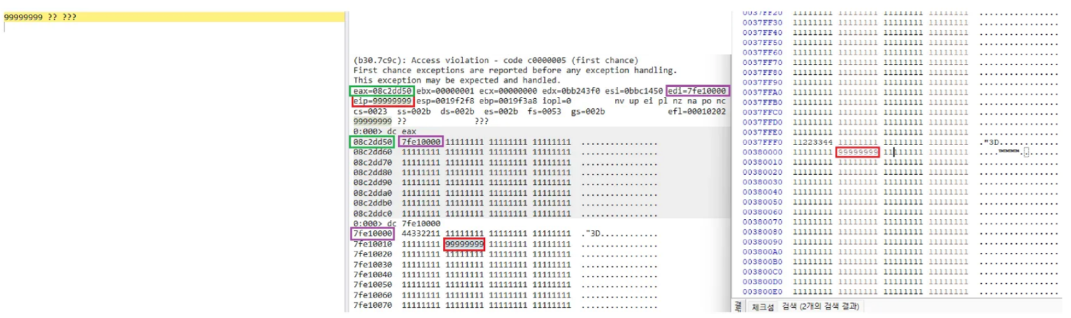
3. Case Study 1
Case Study 1
1. eip 컨트롤이 가능하다! 끝..?
2. cmd, calc -> DEP 우회!
© Hackingcamp. All Rights Reserved

Slide 32
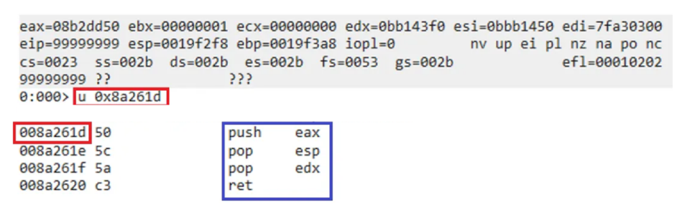
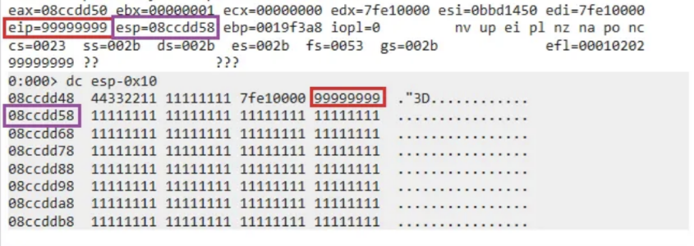
3. Case Study 1
Case Study 1
© Hackingcamp. All Rights Reserved

Slide 33
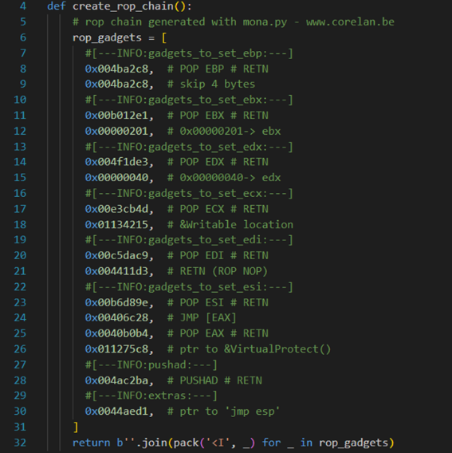
3. Case Study 1
Case Study 1
© Hackingcamp. All Rights Reserved

Slide 34
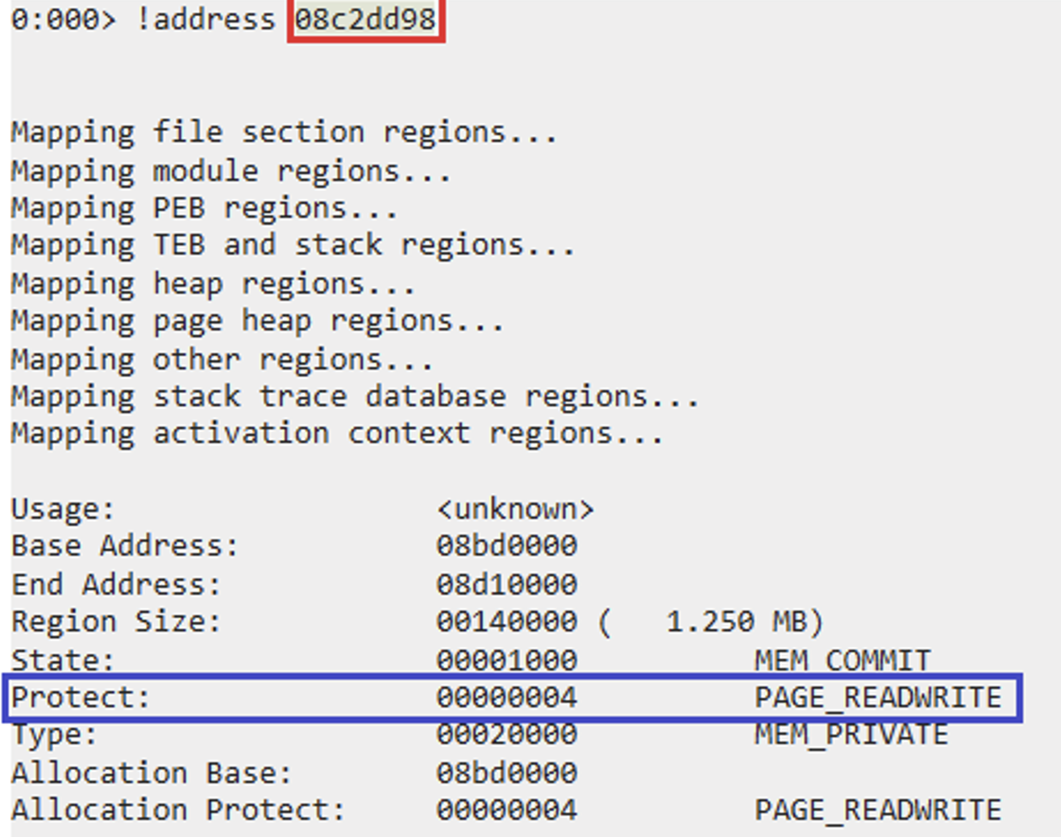
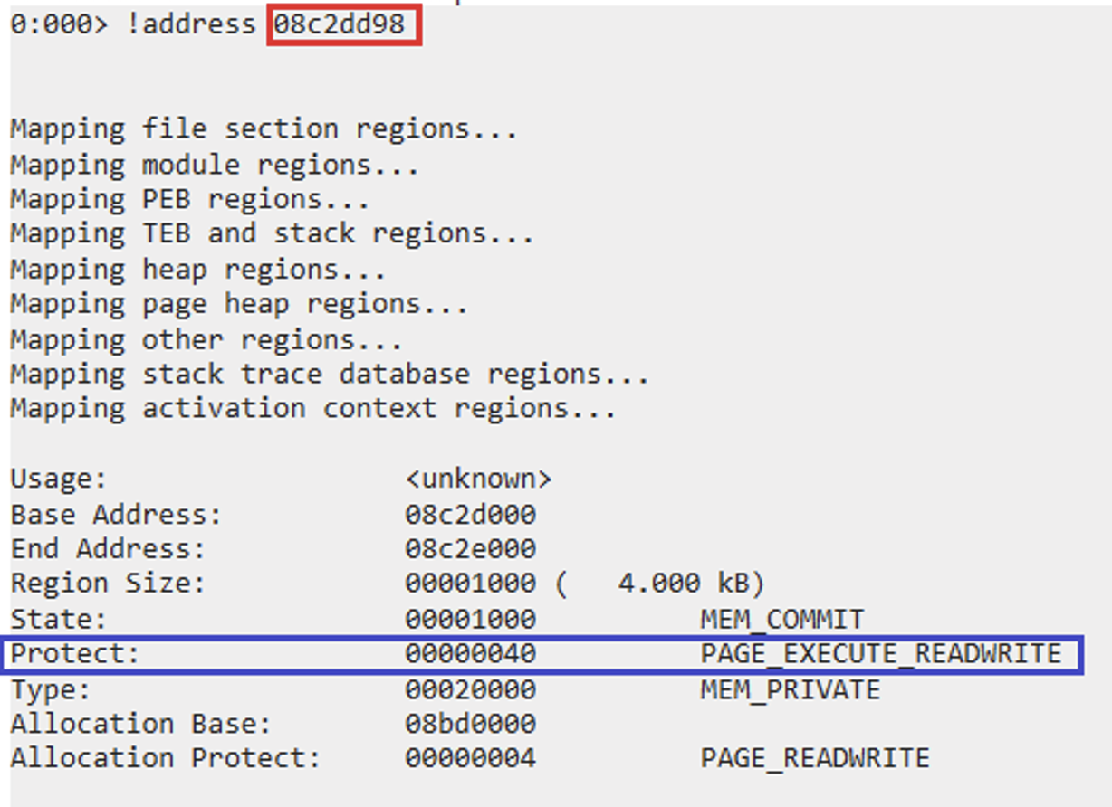

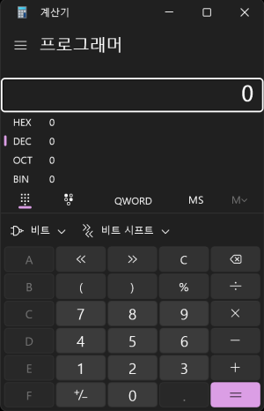
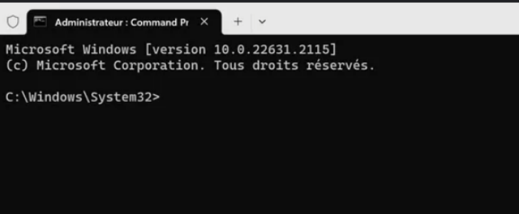
3. Case Study 1
Case Study 1
© Hackingcamp. All Rights Reserved

Slide 35
4. Case Study 2
© Hackingcamp. All Rights Reserved

Slide 36
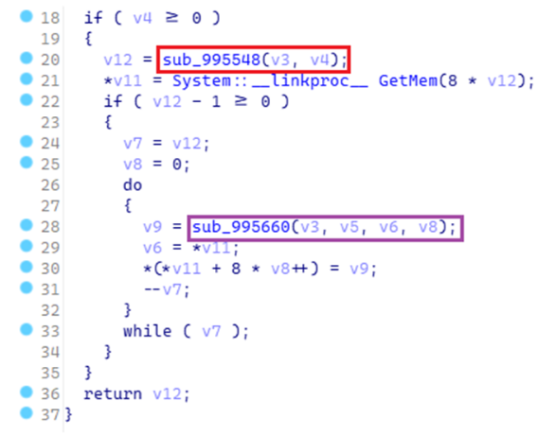
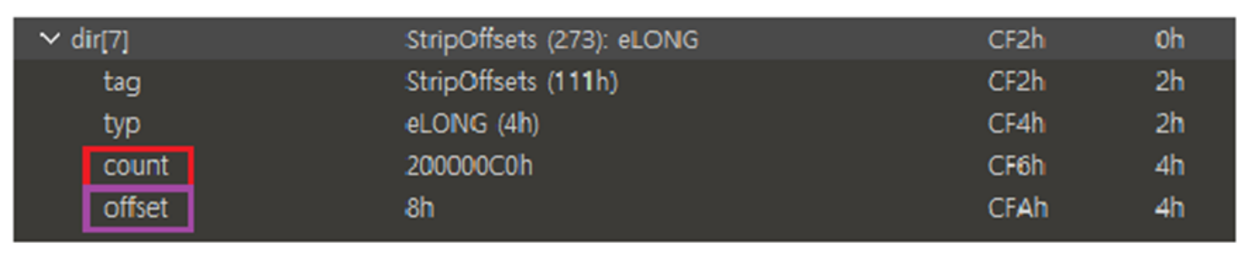
4. Case Study 2
Case Study 2
??? (4byte)
© Hackingcamp. All Rights Reserved

Slide 37
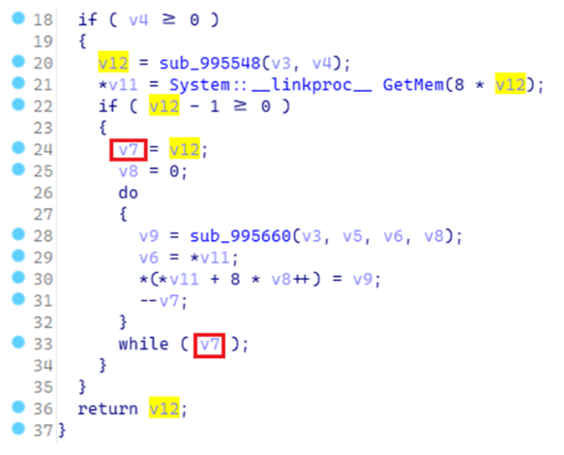
4. Case Study 2
Case Study 2
0x8 * 0x200000C0
= 0x1 0000 0600
GetMem(0x600)
0x200000C0
count : 0x200000C0
oob write !!
© Hackingcamp. All Rights Reserved

Slide 38
5. Case Study 3
© Hackingcamp. All Rights Reserved

Slide 39
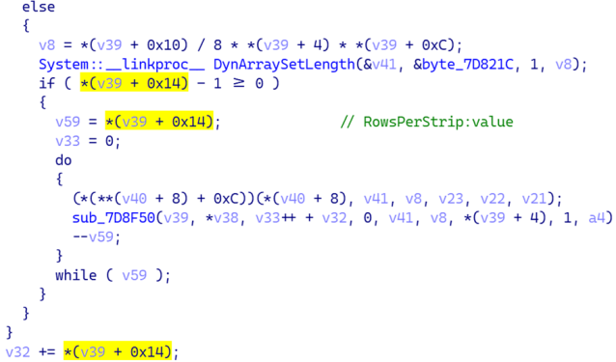

5. Case Study 3
Case Study 3
© Hackingcamp. All Rights Reserved

Slide 40
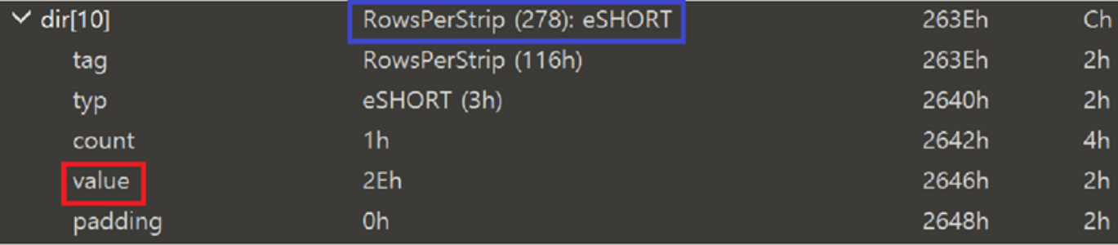
5. Case Study 3
Case Study 3
© Hackingcamp. All Rights Reserved

Slide 41
5. Case Study 3
Case Study 3
© Hackingcamp. All Rights Reserved

Slide 42

5. Case Study 3
Case Study 3
0x2E
0x2E；
0x2E；
© Hackingcamp. All Rights Reserved

Slide 43
5. Case Study 3
Case Study 3
0x2E
0x2E；
0x2E；
© Hackingcamp. All Rights Reserved

Slide 44
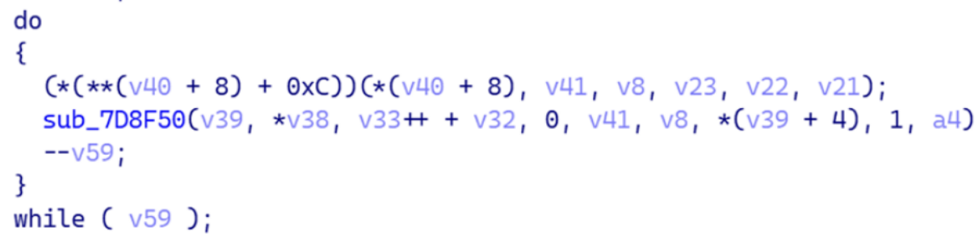

5. Case Study 3
Case Study 3
41 41 41 41 41 41 41
42 42 42 42 42 42 42
43 43 43 43 43 43 43
© Hackingcamp. All Rights Reserved

Slide 45
5. Case Study 3
Case Study 3
41 41 41 41 41 41 41
42 42 42 42 42 42 42
43 43 43 43 43 43 43
??
© Hackingcamp. All Rights Reserved

Slide 46
5. Case Study 3
Case Study 3
B
base 주소 + 0x0(offset)
3. base 주소 + 0x239C(offset)
2. base 주소 + 0x2470(offset)
1. base 주소 + 0x2544(offset)
© Hackingcamp. All Rights Reserved

Slide 47
5. Case Study 3
Case Study 3
범위 : (0 <= v33 <= 0x2d)
0x2e
B
??
base 주소 + 0x0(offset)
1. 0x2e - v33++ + v32 = 0x2e
2. 0x2e -1 = 0x2d
3. 0x2d * 0xd4 = 0x2544(offset)
3. base 주소 + 0x239C(offset)
2. base 주소 + 0x2470(offset)
1. base 주소 + 0x2544(offset)
© Hackingcamp. All Rights Reserved

Slide 48
5. Case Study 3
Case Study 3
범위 : (0 <= v33 <= 0x2d)
B
0x2d
base 주소 + 0x0(offset)
1. 0x2e - v33++ + v32 = 0x2e
2. 0x1 - 1 = 0x0
3. 0x0 * 0xd4 = 0x0(offset)
3. base 주소 + 0x239C(offset)
2. base 주소 + 0x2470(offset)
1. base 주소 + 0x2544(offset)
© Hackingcamp. All Rights Reserved

Slide 49
5. Case Study 3
Case Study 3
© Hackingcamp. All Rights Reserved

Slide 50
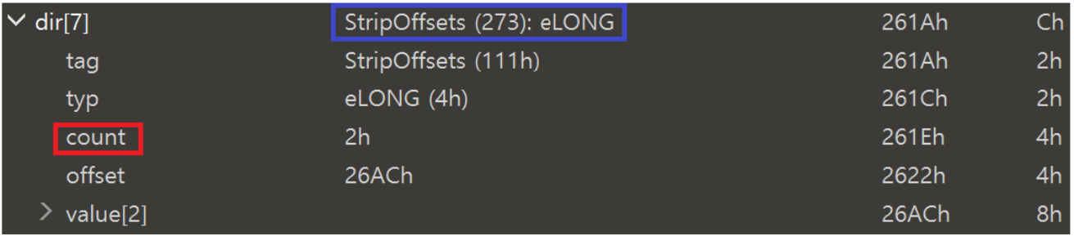
5. Case Study 3
Case Study 3
© Hackingcamp. All Rights Reserved

Slide 51
5. Case Study 3
Case Study 3
범위 : (0 <= v33 <= 0x2d)
© Hackingcamp. All Rights Reserved

Slide 52
5. Case Study 3
Case Study 3
범위 : (0x2e <= v33++ + v32 <= 0x5B)
© Hackingcamp. All Rights Reserved

Slide 53

5. Case Study 3
Case Study 3
범위 : (0x2e <= v33++ + v32 <= 0x5B)
1. 0x2e - 0x2e = 0x0
2. 0x0 -1 = 0xFFFF FFFFF
B
base 주소 + 0xFFFFFF2C
= FFFF FE2C(offset)
3. 0xFFFF FFFFF* 0xd4
base 주소
© Hackingcamp. All Rights Reserved

Slide 54
Case Study 3
범위 : (0x2e <= v33++ + v32 <= 0x5B)
1. 0x2e - 0x2e = 0x0
base 주소 + 0xFFFFFE58
2. 0x0 -1 = 0xFFFF FFFFF
B
base 주소 + 0xFFFFFF2C
= FFFF FE2C(offset)
3. 0xFFFF FFFFF* 0xd4
base 주소
= FFFF FE58(offset)
© Hackingcamp. All Rights Reserved

Slide 55
Case Study 3
범위 : (0x2e <= v33++ + v32 <= 0x5B)
base 주소 + 0xFFFFFD84
1. 0x2e - 0x2e = 0x0
base 주소 + 0xFFFFFE58
2. 0x0 -1 = 0xFFFF FFFFF
B
base 주소 + 0xFFFFFF2C
= FFFF FE2C(offset)
3. 0xFFFF FFFFF* 0xd4
base 주소
= FFFF FE58(offset)
oob write !!
= FFFF FD84(offset)
© Hackingcamp. All Rights Reserved

Slide 56
6. 소감
© Hackingcamp. All Rights Reserved

Slide 57
소감
??? : 알지 알지
1. 취약점은 있다!
2. 분석 방법..?
3. 포기하지 않기!
??? : 분석해봄
© Hackingcamp. All Rights Reserved

Slide 58
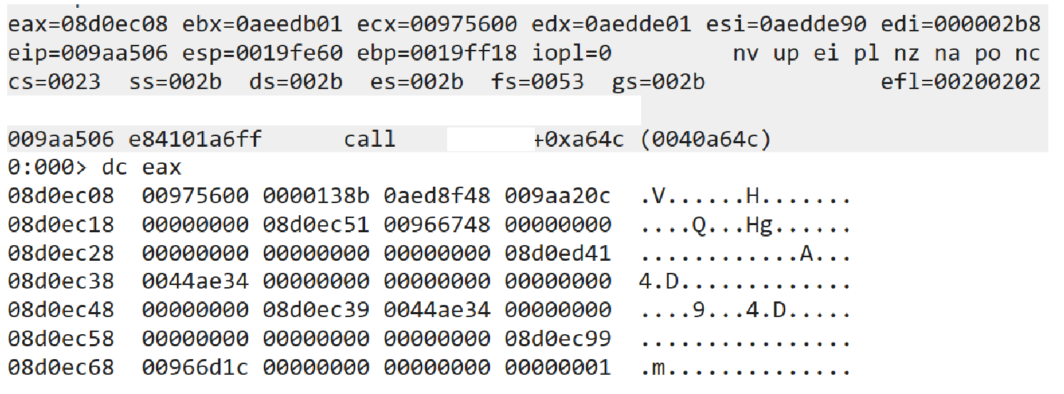
소감
1. 취약점은 있다!
2. 분석 방법..?
3. 포기하지 않기!
© Hackingcamp. All Rights Reserved

Slide 59

소감
1. 취약점은 있다!
2. 분석 방법..?
3. 포기하지 않기!
© Hackingcamp. All Rights Reserved

Slide 60
감사합니다.
QnA
Hackyboiz 정준수
© Hackingcamp. All Rights Reserved

